Slide 1

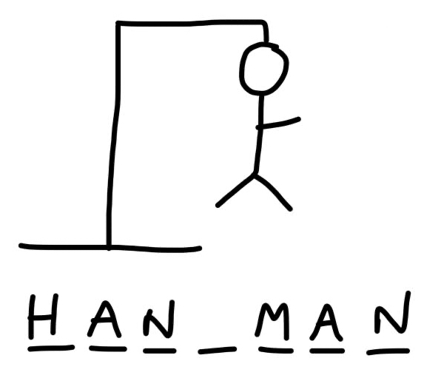
Project 1 - Game Hang Man
Ferdinand Leube – Edgar Tomé

Slide 2
Project 1 - Game Hang Man
Descripton of the Game
Hangman is a guessing game for two players. One player thinks of a word and the other tries to guess it by suggesting letters within a certain number of guesses.

Slide 3
Project 1 - Game Hang Man
Challenges
Setup repository
Plan the project – Jira
Flowchart of the alghoritm
Code alghoritm
Test alghoritm to work acording to the game
Incorporate visulizations

Slide 4
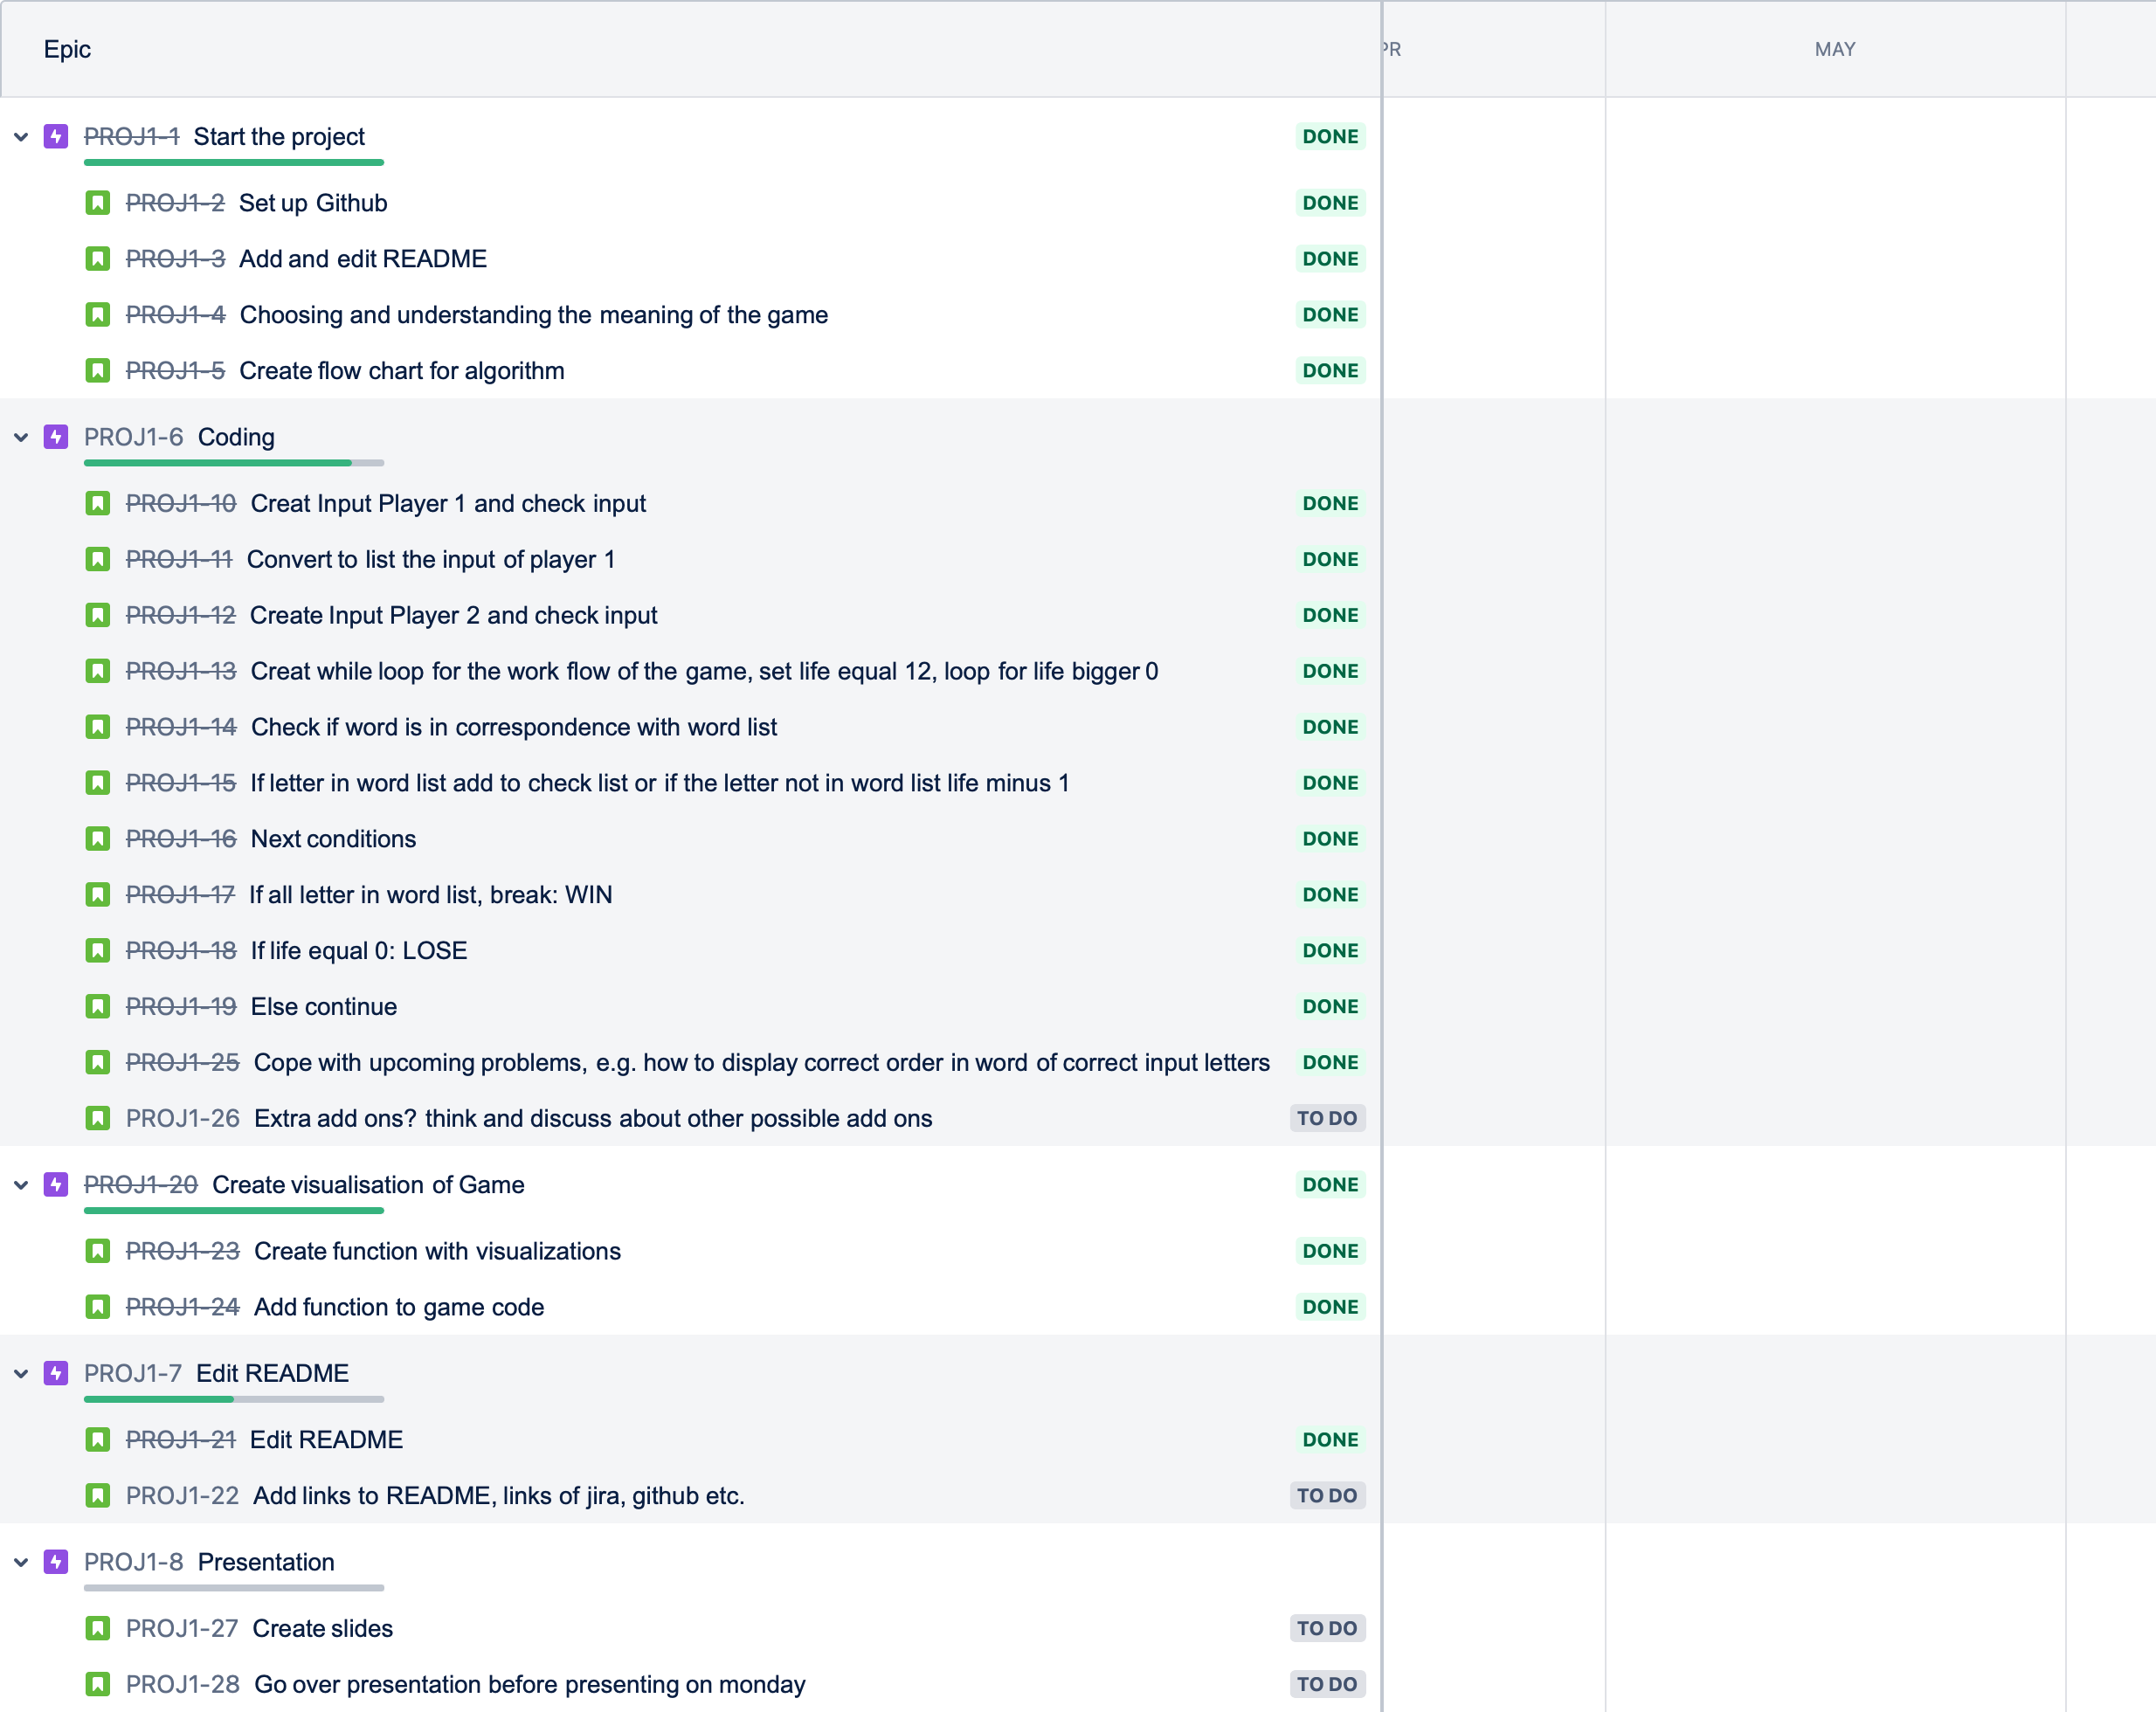
Project 1 - Game Hang Man
Process

Slide 5
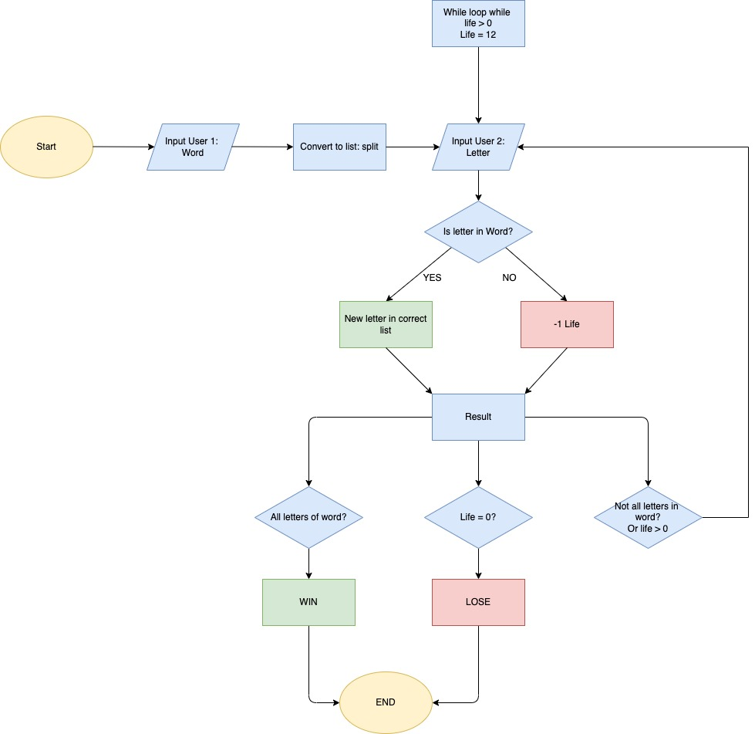
Project 1 - Game Hang Man
Process

Slide 6
Project 1 - Game Hang Man
Highlights
Place the input of player 2 in the same order of input player 1
Consider the input of player 2 the number of times is repetead on the input of player 1

Slide 7
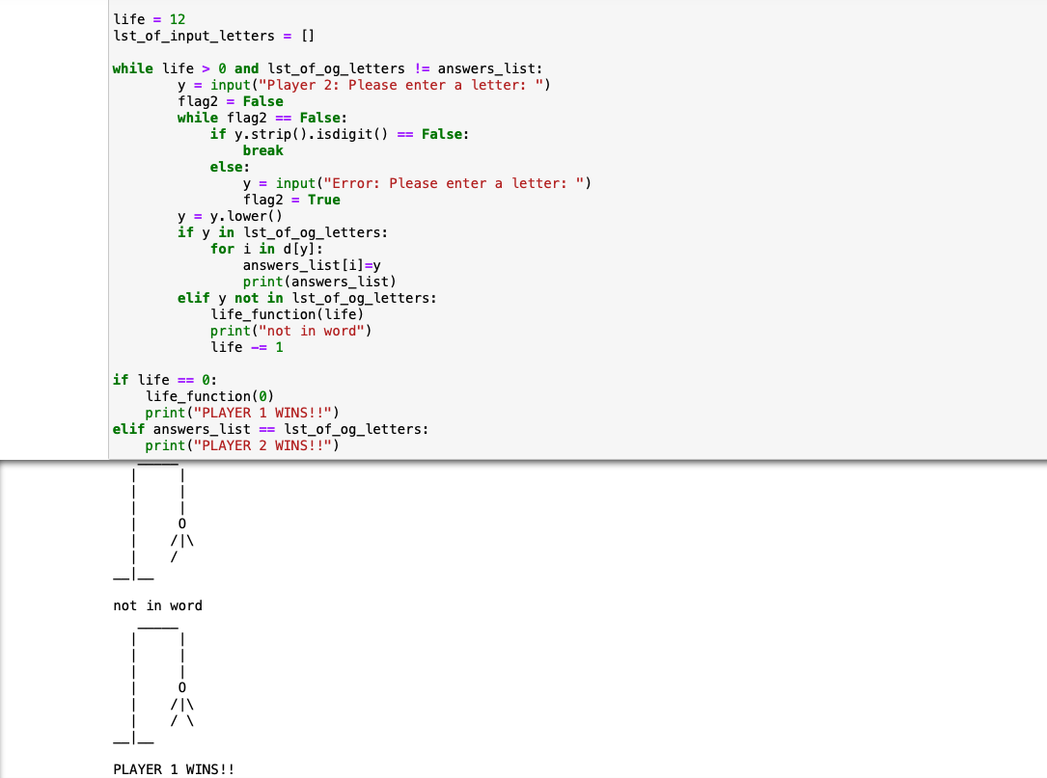
Project 1 - Game Hang Man
Demo

Slide 8
Project 1 - Game Hang Man
Questions
Q & A
TIME

Slide 9
Project 1 - Game Hang Man
End
Thanks

